Slide 1
Chapter 10
Image Segmentation

Slide 2
Chapter 10
Image Segmentation
Image segmentation is a process of sub dividing an image into its constituent parts/objects.
The goal is usually to find individual objects in an image.
Plays a very important role in machine vision applications.
For the most part there are fundamentally two kinds of approaches to segmentation: discontinuity based and similarity based.
  Similarity may be due to pixel intensity, color or texture.
  Differences are sudden changes (discontinuities) in any of these, but especially sudden changes in intensity along a boundary line, which is called an edge.
Notes:
Image segmentation divides an image into regions that are connected and have some similarity within the region and some difference between adjacent regions.

Slide 3
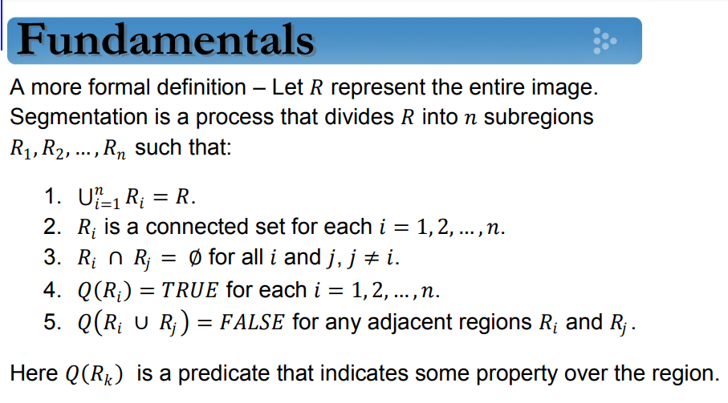


Slide 4
Two approaches
Discontinuity
Similarity
Point
Line
Edge
Thresholding
Region growing
Region splitting & merging
Mask
Notes:
Depending on the nature of the mask, we can perform different operations.

Slide 5
First and Second order derivative properties
Consider the properties of first and second order derivatives as we traverse from left to right
Initially we note that the first-order derivative is non-zero at the onset and along the entire intensity ramp
While the second order derivative is non-zero only at the onset and end of the ramp.

Slide 6
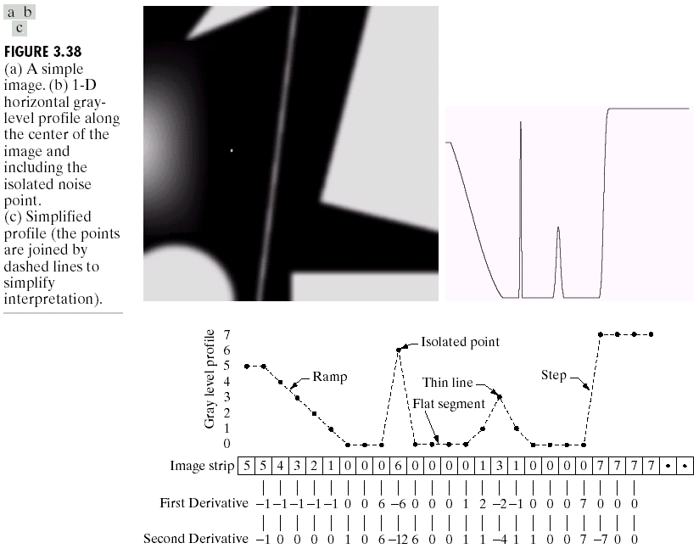

Slide 7
First and Second order derivative properties
We conclude:
  First order derivative produce “thick “edges.
  Second order derivative have stronger response to “finer” details. eg., thin lines, isolated points and noise.
  Second order derivative produce a double-edge response at ramp and step transitions in intensity.
  The sign of the second derivative can be used to determine whether a transition into an edge is from light to dark or vice versa.

Slide 8
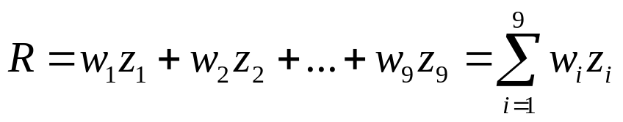
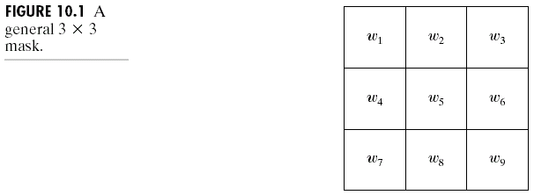
Detection of Discontinuities
There are three kinds of discontinuities of intensity: points, lines and edges.
The most common way to look for discontinuities is to scan a small mask over the image. The mask determines which kind of discontinuity to look for.

Slide 9

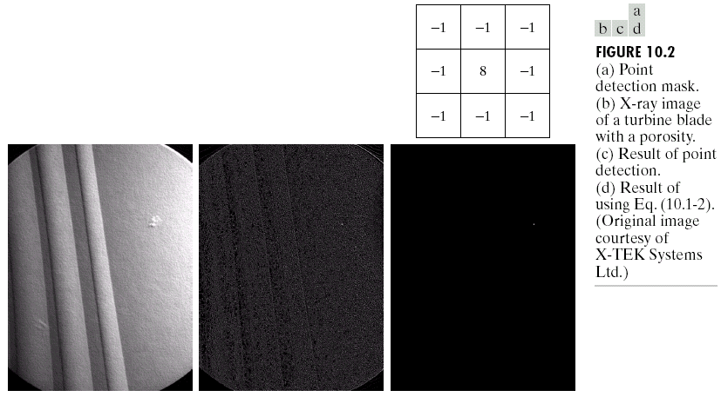
Detection of Discontinuities
Point Detection
Notes:
Based on the conclusions in the preceding section, we know that point detection should be based on the second derivative.

Slide 10
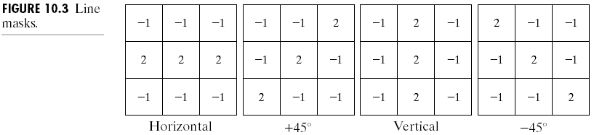
Detection of Discontinuities
Line Detection
Only slightly more common than point detection is to find a one pixel wide line in an image.
For digital images the only three point straight lines are only horizontal, vertical, or diagonal (+ or –45°).
Notes:
-We can apply all the masks on the single image. Greater response for a certain mask implies the presence of that particular orientation lines in the image.
-Alternatively, we can use a single mask eg., +45 degree for detection of lines in the +45 degree direction.

Slide 11
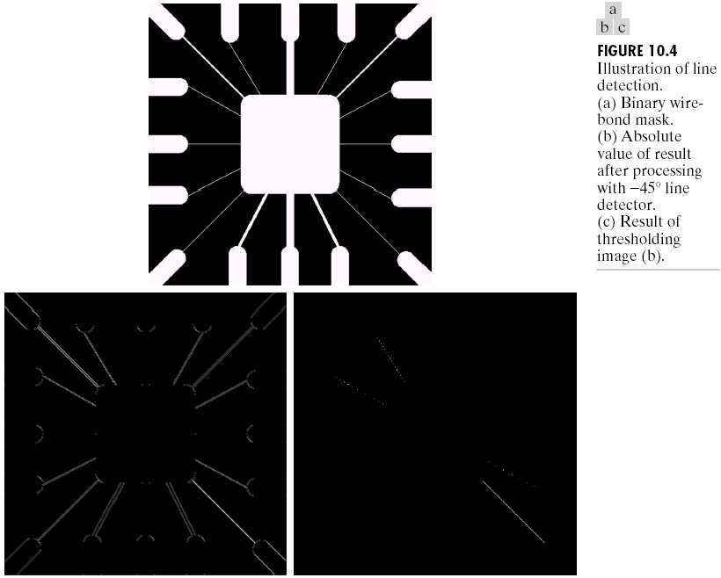
Detection of Discontinuities
Line Detection

Slide 12
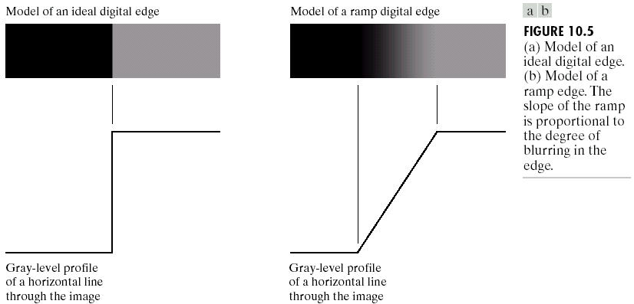
Detection of Discontinuities
Edge Detection
Notes:
An edge is a boundary between two regions having distinct intensity levels.

Slide 13
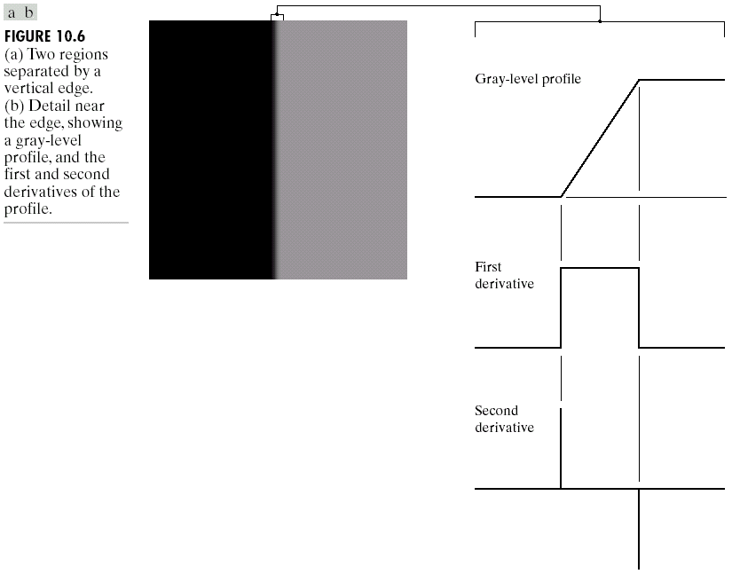
Detection of Discontinuities
Edge Detection
Notes:
Second order derivative is very sensitive to noise and therefore is not used for edge detection.

Slide 14
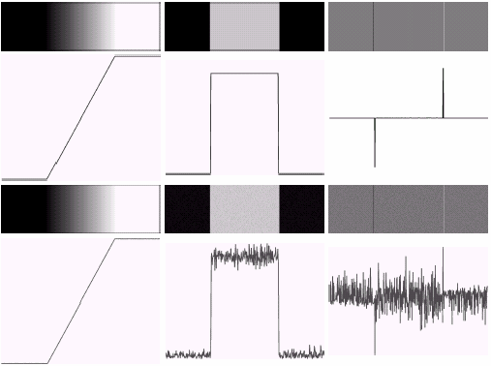

Detection of Discontinuities
Edge Detection

Slide 15
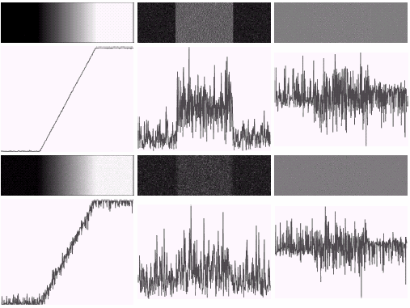
Detection of Discontinuities
Edge Detection

Slide 16
Three fundamental steps performed in edge detection:
  Image smoothing for noise reduction
  Detection of edge points
  Edge localization

Slide 17
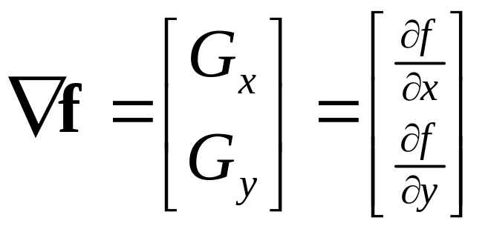
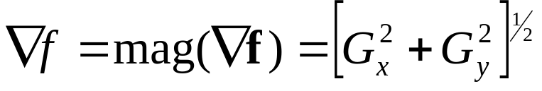
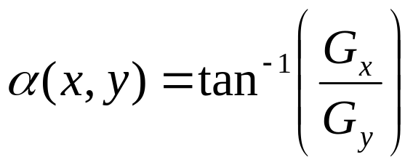
Detection of Discontinuities
Gradient Operators
First-order derivatives:
  The gradient of an image f(x,y) at location (x,y) is defined as the vector:
  The magnitude(edge strength) of this vector:
  The direction of this vector:
Notes:
An image gradient is a directional change in the intensity or color of an image.

Slide 18
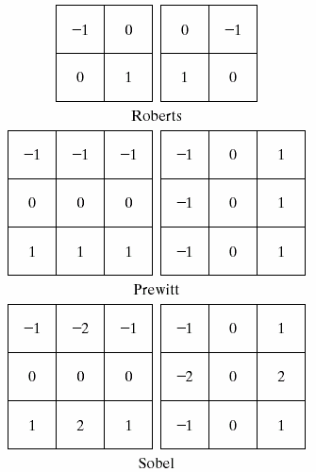
Detection of Discontinuities
Gradient Operators
Roberts cross-gradient operators
Prewitt operators
Sobel operators
Notes:
Sobel Vs Prewitt (First derivative operators)
Sobel gives an averaging affect

Slide 19
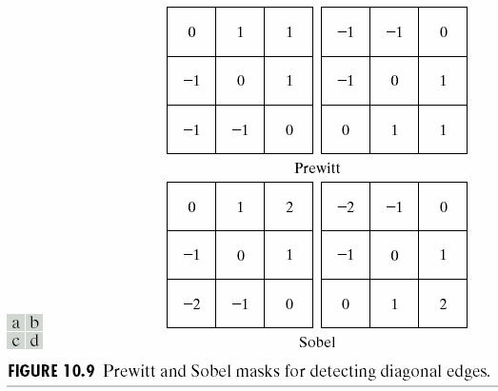
Detection of Discontinuities
Gradient Operators
Prewitt masks for
detecting diagonal edges
Sobel masks for
detecting diagonal edges

Slide 20
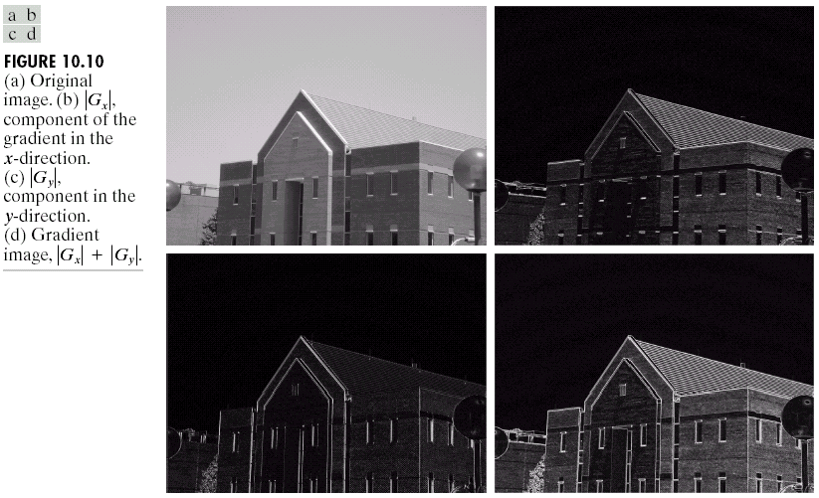

Detection of Discontinuities
Gradient Operators: Example
Notes:
Using sobel operator

Slide 21
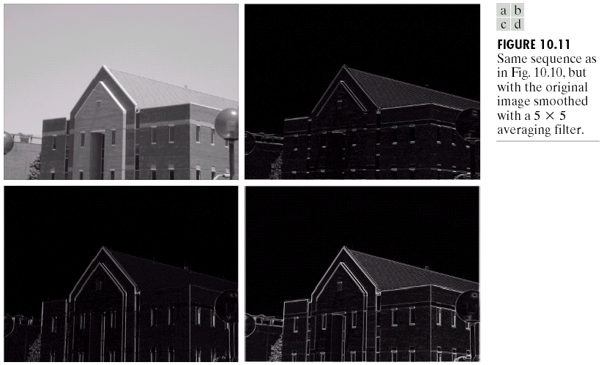
Detection of Discontinuities
Gradient Operators: Example

Slide 22
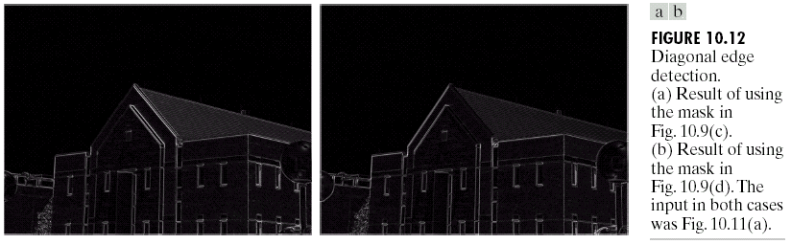
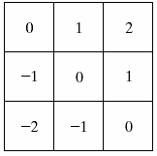
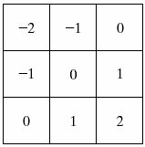
Detection of Discontinuities
Gradient Operators: Example

Slide 23
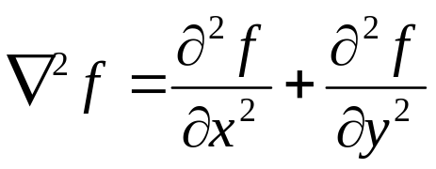
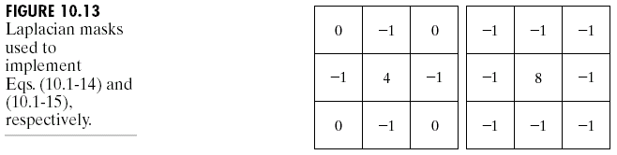
Detection of Discontinuities
Gradient Operators
Second-order derivatives: (The Laplacian)
  The Laplacian of an 2D function f(x,y) is defined as
  Two forms in practice:
Notes:
Second derivative operators gives double edges and are very sensitive to noise, and therefore not normally used for edge detection. But they can be used to extract secondary information.
-By looking at the polarity of the second derivative operator we can make out whether the point lies towards the darker side or the brighter side of the edge.
Zero crossing points accurately determine the location of an edge whenever the edge is a smooth edge.
-Laplacian is an example of such a second order derivative operator.
-Laplacian was earlier used for enhancement of image details. Now, we will use them for edge detection operation.

Slide 24
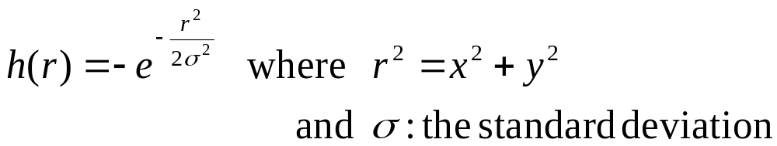
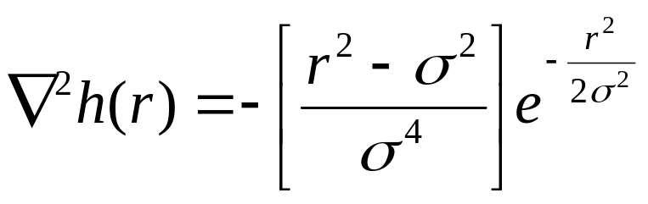
Detection of Discontinuities
Gradient Operators:
Using the Marr-Hildreth Edge Detector
Consider the function:
The Laplacian of h is
The Laplacian of a Gaussian sometimes is called the Mexican hat function. It also can be computed by smoothing the image with the Gaussian smoothing mask, followed by application of the Laplacian mask.
A Gaussian function
The Laplacian of a Gaussian (LoG)
Notes:
--To reduce the sensitivity of laplacian to noise, the image can be smoothened using a gaussian function. And later can be used together.
- Also called LoG(Laplacian of Gaussian)

Slide 25
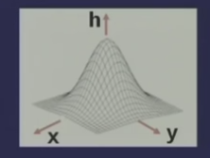
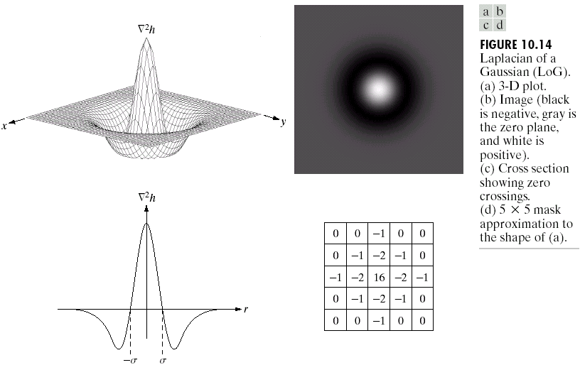
Detection of Discontinuities
Gradient Operators
Notes:
LoG value at (0,0) is a maximum positive value.

Slide 26
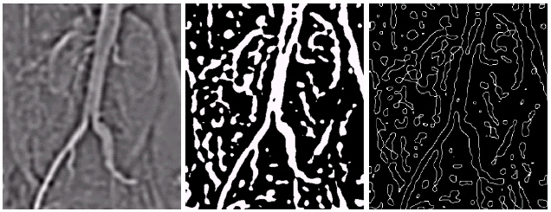
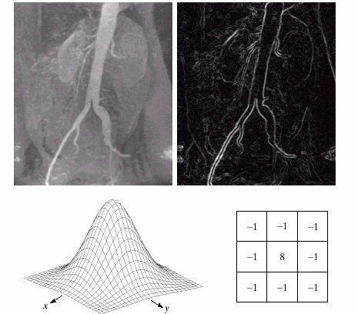
Detection of Discontinuities
Gradient Operators: Example
Gaussian smooth function
Laplacian mask

Slide 27
Edge Linking and Boundary Detection
Ideally discontinuity detection techniques should identify pixels lying on the boundary between regions.
In practice there may be breaks in boundary and spurious intensity discontinuities due to:
  Non uniform illumination
  Presence of noise

Slide 28
Edge linking procedures assembles edge points into meaningful boundaries
Two Edge linking approaches
Local processing
Global processing
Notes:
Sometimes edges may be disconnected or non continuous due to non uniform illumination or presence of niose. And therefore, To link edge points in order to get a meaningful edge description.

Slide 29
Edge Linking and Boundary Detection
Steps:
  Take an edge detected image
  Analyze each pixel in a small neighborhood of every point(x,y)
    All points that are similar in nature are linked
    This forms a boundary of pixels that are similar in nature

Slide 30
Edge Linking and Boundary Detection
Local Processing
  Two similarity properties of edge points are useful for edge linking:
    the strength (or magnitude) of the detected edge points
    their directions (determined from gradient directions)
  This is usually done in local neighborhoods.
  Adjacent edge points with similar magnitude and direction are linked.
    For example, an edge pixel with coordinates (x₀,y₀) in a predefined neighborhood of (x,y) is similar to the pixel at (x,y) if
Notes:
Take an image that is already edge operated.
If two points are similar then we need to have a similarity criteria:- Strength and direction.

Slide 31
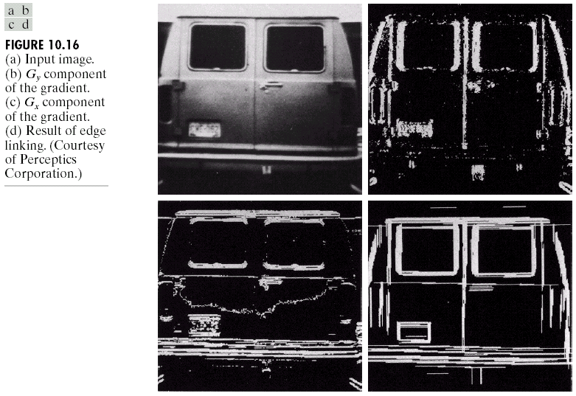
Edge Linking and Boundary Detection
Local Processing: Example
In this example,
we can find the
license plate
candidate after
edge linking
process.

Slide 32
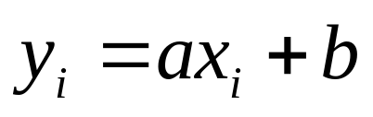
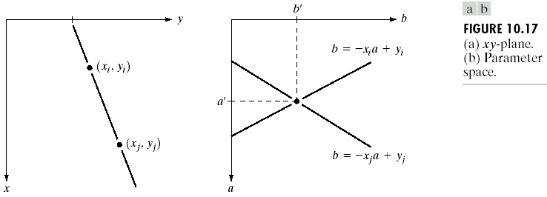
Edge Linking and Boundary Detection
Global Processing via the Hough Transform
Hough transform: a way of finding edge points in an image that lie along a straight line.
Example: xy-plane v.s. ab-plane (parameter space)
Notes:
If the edge points are far apart, then local processing cannot be used. We have to use the global processing technique.

Slide 33
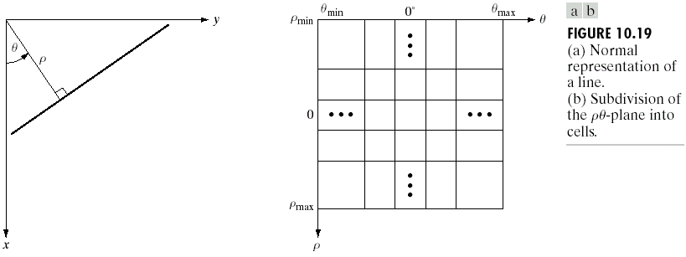
Chapter 10
Image Segmentation

Slide 34
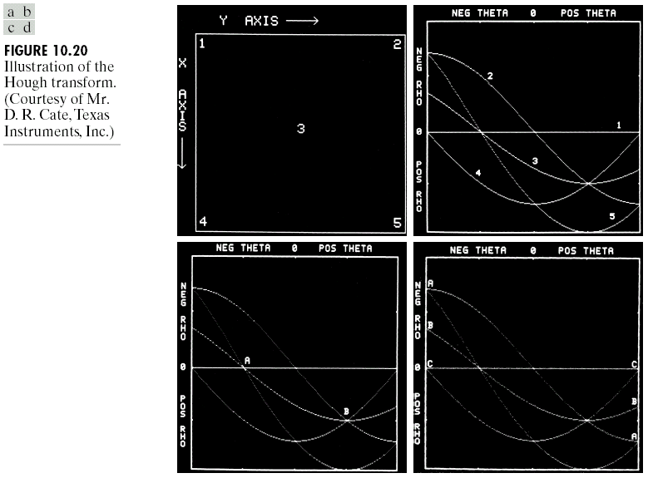
Chapter 10
Image Segmentation

Slide 35
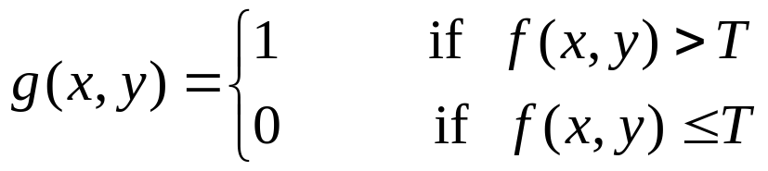
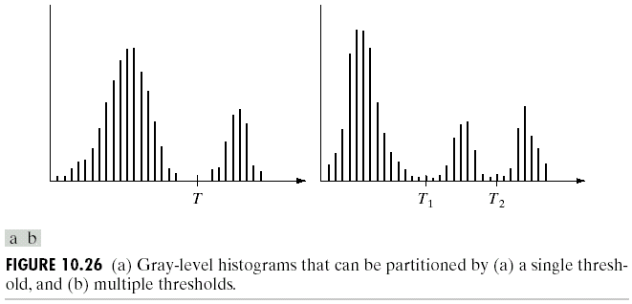
Thresholding
Assumption: the range of intensity levels covered by objects of interest is different from the background.
Single threshold
Multiple threshold

Slide 36
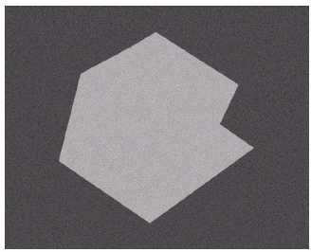
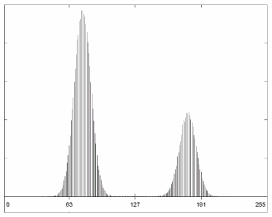
Thresholding

Slide 37
Region-Based Segmentation
Region growing is a procedure which groups the pixels or sub regions into a larger region based on some predefined criteria.
  Here, the pre defined criteria is the predicate.
Notes:
We start from a single point and try to find out what are the other points that can be grouped into the same group which follows the same criteria or for which the predicate is true.
Steps: 1. Choose a seed point. Region growing operation will start from here.
2. New points will be added to the seed point based on a condition
3. Those new points will further be used for growing using a condition (eg. If difference is low then the pixels are similar)
4. Stop growing if the predicate/condition is no longer fulfilled.
Conditions to be taken into consideration:
Every region/partition have to be connected

Slide 38
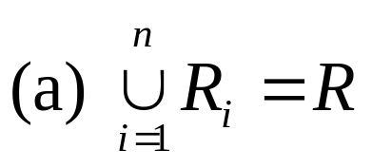


Region-Based Segmentation
Basic Formulation
Let R represent the entire image region.
Segmentation is a process that partitions R into subregions, R₁,R₂,…,R_{n}, such that
where P(R_{k}): a logical predicate defined over the points in set R_{k}
For example: P(R_{k})=TRUE if all pixels in R_{k} have the same gray level.

Slide 39
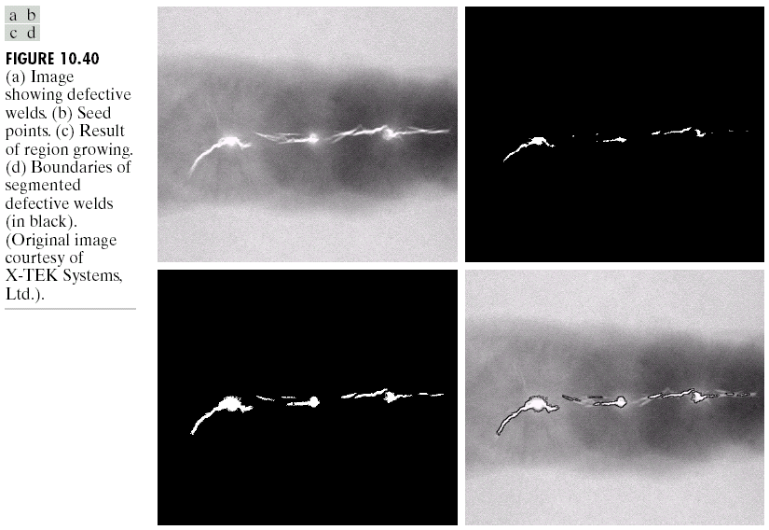
Region-Based Segmentation
Region Growing
Notes:
*Faults appear as higher intensity values in the thresholded image.
Seeds are selected from the thresholded image.
But the region growing operation is performed on the original image.
The thresholded image is used only for the selection of the seed points.
After the region growing operation, the region grown image(which gives the boundary) is superimposed on the original image which gives us the final output image.

Slide 40
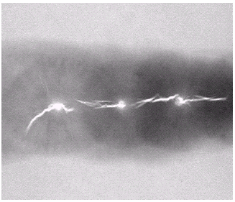
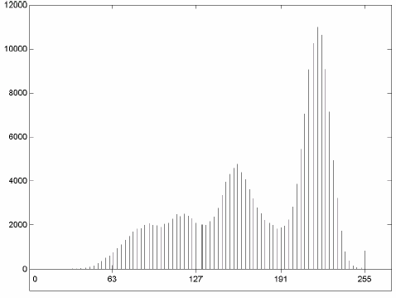
Region-Based Segmentation
Region Growing
Fig. 10.41 shows the histogram of Fig. 10.40 (a). It is difficult to segment the defects by thresholding methods. (Applying region growing methods are better in this case.)
Figure 10.40(a)
Figure 10.41

Slide 41
Region-Based Segmentation
Region Splitting and Merging
Region splitting is the opposite of region growing.
  First there is a large region (possible the entire image).
  Then a predicate (measurement) is used to determine if the region is uniform.
  If not, then the method requires that the region be split into two regions.
  Then each of these two regions is independently tested by the predicate (measurement).
  This procedure continues until all resulting regions are uniform.
Notes:
Similar to region growing we are trying to form a segment of all the pixels which are similar in intensity values or satisfy a predicate.

Slide 42
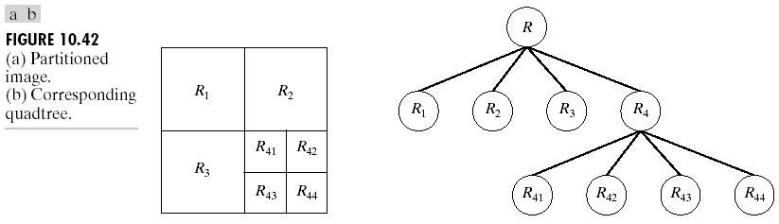
Region-Based Segmentation
Region Splitting
The main problem with region splitting is determining where to split a region.
One method to divide a region is to use a quadtree structure.
Quadtree: a tree in which nodes have exactly four descendants.

